Slide 1
Software Risk Management
Matakuliah Rekayasa Perangkat Lunak (CS215) – Gasal 2015/2016
Magister Ilmu Komputer - Universitas Budi Luhur
Achmad Solichin, S.Kom, M.T.I (achmatim@gmail.com)

Slide 2
Overview
What is Software Risk Management?
Risk Management Process
Risk Management Strategies
Risk Metrics (Risk Estimation)
International Risk Management Standards.

Slide 3
Important Goals of Project Management
Deliver the software to the customer at the agreed time.
Keep overall costs within budget.
Deliver software that meets the customer’s expectations.
Maintain a happy and well-functioning development team.
[Pressman, 2010]

Slide 4
Project Manager Responsibility
Project planning. Project managers are responsible for planning, estimating and scheduling project development, and assigning people to tasks.
Reporting. Project managers are usually responsible for reporting on the progress of a project to customers and to the managers of the company developing the software.
Risk management. Project managers have to assess the risks that may affect a project, monitor these risks, and take action when problems arise
People management. Project managers are responsible for managing a team of people.
Proposal writing. The first stage in a software project may involve writing a proposal to win a contract to carry out an item of work
[Sommerville, 2011]

Slide 5
Risk Management
Risk management involves anticipating risks that might affect the project schedule or the quality of the software being developed, and then taking action to avoid these risks (Hall, 1998; Ould, 1999)
Three categories of Risk:
Project risks. Risks that affect the project schedule or resources. Ex: the loss of an experienced designer.
Product risks. Risks that affect the quality or performance of the software being developed. Ex: the failure of a purchased component to perform as expected.
Business risks. Risks that affect the organization developing or procuring the software. Ex: a competitor introducing a new product.
[Sommerville, 2011]

Slide 6
Reactive Risk Management
Project team reacts to risks when they occur.
Mitigation—plan for additional resources in anticipation of fire fighting
Fix on failure—resource are found and applied when the risk strikes
Crisis management—failure does not respond to applied resources and project is in jeopardy.
[Pressman, 2010]

Slide 7
Proactive Risk Management
Formal risk analysis is performed.
Organization corrects the root causes of risk
TQM (total quality management) concepts and statistical SQA
Examining risk sources that lie beyond the bounds of the software
Developing the skill to manage change
[Pressman, 2010]

Slide 8
Principle of Risk Management
Maintain a global perspective—view software risks within the context of a system in which it is a component and the business problem that it is intended to solve
Take a forward-looking view—think about the risks that may arise in the future (e.g., due to changes in the software); establish contingency plans so that future events are manageable.
Encourage open communication—if someone states a potential risk, don’t discount it. If a risk is proposed in an informal manner, consider it. Encourage all stakeholders and users to suggest risks at any time.
Integrate—a consideration of risk must be integrated into the software process.
Emphasize a continuous process—the team must be vigilant throughout the software process, modifying identified risks as more information is known and adding new ones as better insight is achieved.
Develop a shared product vision—if all stakeholders share the same vision of the software, it is likely that better risk identification and assessment will occur.
Encourage teamwork—the talents, skills, and knowledge of all stakeholders should be pooled when risk management activities are conducted.
[Pressman, 2010]

Slide 9
Example of Risks
Risk | Affects | Description
Staff turnover | Project | Experienced staff will leave the project before it is finished.
Management change | Project | There will be a change of organizational management with different priorities.
Hardware unavailability | Project | Hardware that is essential for the project will not be delivered on schedule.
Requirements change | Project and product | There will be a larger number of changes to the requirements than anticipated.
Specification delays | Project and product | Specifications of essential interfaces are not available on schedule.
Size underestimate | Project and product | The size of the system has been underestimated.
CASE tool underperformance | Product | CASE tools, which support the project, do not perform as anticipated.
Technology change | Business | The underlying technology on which the system is built is superseded by new technology.
Product competition | Business | A competitive product is marketed before the system is completed.
[Sommerville, 2011]

Slide 10
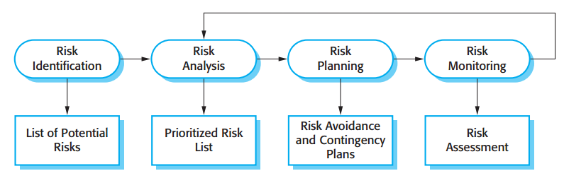
The Risk Management Process
[Sommerville, 2011]

Slide 11
Risk Identification
May be a team activities or based on the individual project manager’s experience.
Six types of common risk:
Technology risks. Risks that derive from the software or hardware technologies that are used to develop the system.
People risks. Risks that are associated with the people in the development team.
Organizational risks. Risks that derive from the organizational environment where the software is being developed.
Tools risks. Risks that derive from the software tools and other support software used to develop the system.
Requirements risks. Risks that derive from changes to the customer requirements and the process of managing the requirements change.
Estimation risks. Risks that derive from the management estimates of the resources required to build the system.
[Sommerville, 2011]

Slide 12
Risk Identification
Risk type | Possible risks
Technology | The database used in the system cannot process as many transactions per second as expected. (1) Reusable software components contain defects that mean they cannot be reused as planned. (2)
People | It is impossible to recruit staff with the skills required. (3) Key staff are ill and unavailable at critical times. (4) Required training for staff is not available. (5)
Organizational | The organization is restructured so that different management are responsible for the project. (6) Organizational financial problems force reductions in the project budget. (7)
Tools | The code generated by software code generation tools is inefficient. (8) Software tools cannot work together in an integrated way. (9)
Requirements | Changes to requirements that require major design rework are proposed. (10) Customers fail to understand the impact of requirements changes. (11)
Estimation | The time required to develop the software is underestimated. (12) The rate of defect repair is underestimated. (13) The size of the software is underestimated. (14)
[Sommerville, 2011]

Slide 13
Risk Analysis
Assess probability and seriousness of each risk.
Probability may be: Very Low (< 10%), Low (10-25%), Moderate (25-50%), High (50-75%) or Very High (> 75%).
Risk consequences might be: Catastrophic (threaten the survival of the project), Serious (would cause major delays), Tolerable (delays are within allowed contingency), or Insignificant.
[Sommerville, 2011]

Slide 14
Risk Types and Example
Risk | Probability | Effects
Organizational financial problems force reductions in the project budget (7). | Low | Catastrophic
It is impossible to recruit staff with the skills required for the project (3). | High | Catastrophic
Key staff are ill at critical times in the project (4). | Moderate | Serious
Faults in reusable software components have to be repaired before these components are reused. (2). | Moderate | Serious
Changes to requirements that require major design rework are proposed (10). | Moderate | Serious
The organization is restructured so that different management are responsible for the project (6). | High | Serious
The database used in the system cannot process as many transactions per second as expected (1). | Moderate | Serious
[Sommerville, 2011]

Slide 15
Risk Types and Example
Risk | Probability | Effects
The time required to develop the software is underestimated (12). | High | Serious
Software tools cannot be integrated (9). | High | Tolerable
Customers fail to understand the impact of requirements changes (11). | Moderate | Tolerable
Required training for staff is not available (5). | Moderate | Tolerable
The rate of defect repair is underestimated (13). | Moderate | Tolerable
The size of the software is underestimated (14). | High | Tolerable
Code generated by code generation tools is inefficient (8). | Moderate | Insignificant
[Sommerville, 2011]

Slide 16
Risk Projection
Also called Risk Estimation
Risk Projection steps:
Establish a scale that reflects the perceived likelihood of a risk.
Delineate the consequences of the risk.
Estimate the impact of the risk on the project and the product.
Assess the overall accuracy of the risk projection so that there will be no misunderstandings.
[Pressman, 2010]

Slide 17
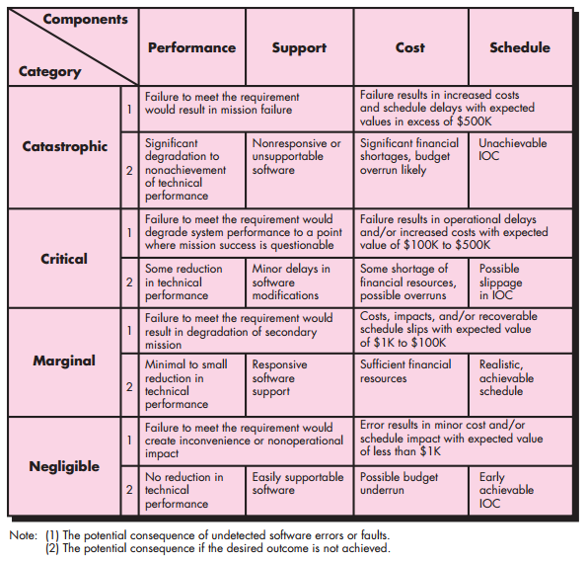
Risk Impact Assessment
[Pressman, 2010]

Slide 18
Risk Planning
Consider each risk and develop a strategy to manage that risk.
Risk strategies:
Avoidance strategies. The probability that the risk will arise is reduced.
Minimization strategies. The impact of the risk on the project or product will be reduced.
Contingency plans. If the risk arises, contingency plans are plans to deal with that risk.
[Sommerville, 2011]

Slide 19
Risk Management Strategies
Risk | Strategy
Organizational financial problems | Prepare a briefing document for senior management showing how the project is making a very important contribution to the goals of the business and presenting reasons why cuts to the project budget would not be cost-effective.
Recruitment problems | Alert customer to potential difficulties and the possibility of delays; investigate buying-in components.
Staff illness | Reorganize team so that there is more overlap of work and people therefore understand each other’s jobs.
Defective components | Replace potentially defective components with bought-in components of known reliability.
Requirements changes | Derive traceability information to assess requirements change impact; maximize information hiding in the design.
[Sommerville, 2011]

Slide 20
Risk Management Strategies
Risk | Strategy
Organizational restructuring | Prepare a briefing document for senior management showing how the project is making a very important contribution to the goals of the business.
Database performance | Investigate the possibility of buying a higher-performance database.
Underestimated development time | Investigate buying-in components; investigate use of a program generator.
[Sommerville, 2011]

Slide 21
Risk Monitoring
Assess each identified risks regularly to decide whether or not it is becoming less or more probable.
Also assess whether the effects of the risk have changed.
Each key risk should be discussed at management progress meetings.
[Sommerville, 2011]

Slide 22
Risk Indicators
Risk type | Potential indicators
Technology | Late delivery of hardware or support software; many reported technology problems.
People | Poor staff morale; poor relationships amongst team members; high staff turnover.
Organizational | Organizational gossip; lack of action by senior management.
Tools | Reluctance by team members to use tools; complaints about CASE tools; demands for higher-powered workstations.
Requirements | Many requirements change requests; customer complaints.
Estimation | Failure to meet agreed schedule; failure to clear reported defects.
[Sommerville, 2011]

Slide 23
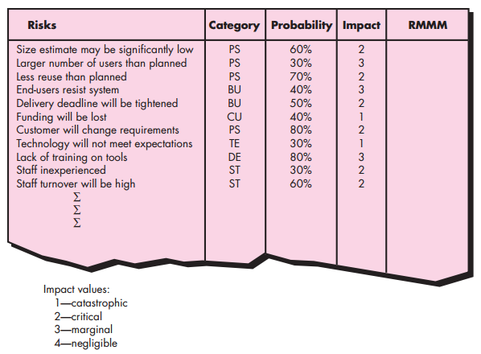
Developing a Risk Table
[Pressman, 2010]

Slide 24

Risk Exposure (RE)
$$RE=P ∗ C$$
Dimana:
RE = Risk Exposure
P = Probability of occurrence for a risk
C = cost to the project should the risk occur
[Pressman, 2010]

Slide 25
Risk Exposure (RE)
Risk identification. Only 70 percent of the software components scheduled for reuse will, in fact, be integrated into the application. The remaining functionality will have to be custom developed.
Risk probability. 80 percent (likely).
Risk impact. Sixty reusable software components were planned. If only 70 percent can be used, 18 components would have to be developed from scratch (in addition to other custom software that has been scheduled for development). Since the average component is 100 LOC and local data indicate that the software engineering cost for each LOC is $14.00, the overall cost (impact) to develop the components would be 18 x 100 x $14 = $25,200.
Risk exposure. RE = 0.80 x $25,200 ≈ $20,200.
[Pressman, 2010]
Notes:
LOC = line of code

Slide 26
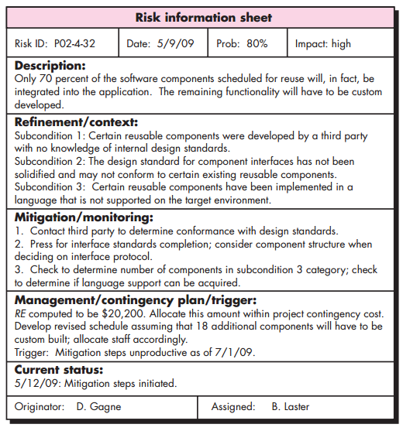
Risk Information Sheet (RIS)
[Pressman, 2010]
Notes:
LOC = line of code

Slide 27
International Risk Management Standards
COSO ERM (2004)
Applies to management, directors, regulators, academics and others who are interested in better understanding enterprise risk management
COSO ERM is a framework providing integrated principles, common terminology and practical implementation guidance supporting entities' programs to develop or benchmark their enterprise risk management processes.
This standard is voluntary.

Slide 28
International Risk Management Standards
ISO 31000: Risk Management (2009)
Applies to any public, private or community enterprise, association, group or individual. Therefore, it is not specific to any industry or sector.
ISO 31000 provides principles and generic guidelines on risk management. Applies to any type of risk, whatever its nature, whether having positive or negative consequences.

Slide 29
International Risk Management Standards
ISO/IEC 31010: Risk Management – Risk Assessment Techniques (2009)
Applies to any public, private or community enterprise, association, group or individual. Therefore, it is not specific to any industry or sector.
ISO 31010 assists organizations in implementing the risk management principles and guidelines provided by the recently published ISO 31000:2009, itself complemented by ISO Guide 73:2009 on risk management vocabulary. This standard deals with risk assessment concepts, risk assessment process, and selection of risk assessment techniques. This standard is not intended for certification, regulatory or contractual use.

Slide 30
International Risk Management Standards
ISO/IEC Guide 73: Risk Management Guidelines (2009)
Applies to those engaged in managing risks, those who are involved in activities of ISO and IEC, and developers of national or sector-specific standards, guides, procedures and codes of practice relating to the management of risk
The guide provides the definitions of generic terms related to risk management. It aims to encourage a mutual and consistent understanding of, and a coherent approach to, the description of activities relating to the management of risk, and the use of uniform risk management terminology in processes and frameworks dealing with the management of risk.

Slide 31
International Risk Management Standards
BS 31100 (Risk Management)
Applies to any organization of any size
BS 31100 provides a foundation for organizations to understand, create, integrate and maintain risk management programs by giving recommendations on its model, framework, and process with the goal of increasing the organizations chances of meeting its objectives.

Slide 32
Some interesting stuff…
https://www.youtube.com/watch?v=PZmNZi8bon8
https://www.youtube.com/watch?v=n9d7EMEzaHU

Slide 33
A Small Case Study
Lintang adalah seorang freelancer yang tinggal di Tangerang. Sebagai web developer, Lintang sudah 4 tahun berpengalaman membangun berbagai aplikasi berbasis web. Saat ini, Lintang juga sedang terikat kontrak maintenance sebuah sistem HRIS berbasis web di perusahaan XYZ selama setahun mendatang. Selain itu, Lintang juga sedang melanjutkan studi di Magister Ilmu Komputer, Universitas Budi Luhur (semester 3).
Suatu hari, seorang kenalan bernama Mulyanto menawarkan sebuah project untuk membangun sistem informasi laundry berbasis web. Berdasarkan hasil pertemuan antara Lintang dan Mulyanto, diperoleh beberapa informasi terkait project yg ditawarkan. Mulyanto memiliki 4 usaha laundry yang tersebar di sejumlah tempat di Jakarta dan Tangerang. Sebagai pemilik, Mulyanto ingin mengetahui dan mengontrol dg cepat bagaimana bisnis laundry dijalankan oleh anak buahnya, melalui sebuah aplikasi berbasis web. Mulai dari proses penyerahan pakaian oleh pelanggan, proses pengerjaan oleh pegawai hingga pendapatan untuk setiap pegawai harus tercatat dg baik di aplikasi. Selain berdasarkan kehadiran, pendapatan masing2 pegawai juga dihitung berdasarkan jumlah pekerjaan yang dilakukan.
Sebagai seorang lulusan kampus ternama, Mulyanto sudah menyusun rancangan aplikasi yang diinginkan, mulai dari rancangan layar, rancangan masukan, rumus / perhitungan, rancangan basis data hingga rancangan laporan. Semua disusun berdasarkan pengalaman Mulyanto menangani bisnis laundry. Memang, Mulyanto termasuk orang yg sangat perfeksionis dan selektif dlm mengerjakan sesuatu. Kali ini dia mencari seorang programmer berpengalaman yg sanggup mengimplementasikan rancangannya menjadi sebuah aplikasi yg dapat langsung digunakan setidaknya 2 bulan mendatang. Mulyanto menjanjikan kompensasi yang cukup besar untuk pekerjaan ini.
Menurut Anda, Lintang harus menerima atau menolak tawaran project dari Mulyanto? Jelaskan!

Slide 34
References
Roger S. Pressman, 2010, Software Engineering: A Practitioner’s Approach 7th edition, McGraw-Hill.
Ian Sommerville, 2011, Software Engineering 9th edition, Addison-Wesley.
Other references

Slide 35
Thanks
Achmad Solichin, S.Kom, M.T.I
achmatim@gmail.com
Twitter: @achmatim
Facebook: facebook.com/achmatim
Web: http://achmatim.net

